Slide 1
Migration and Human Capital
2

Slide 2
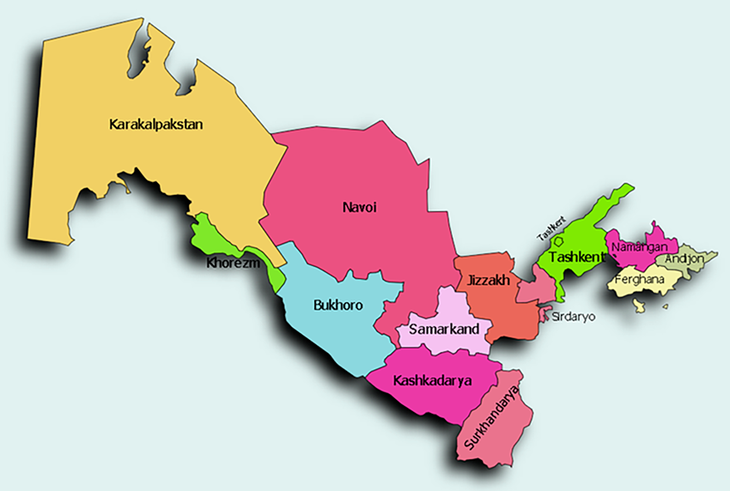
Migration by type of crossed territorial unit
Which type of migration affects the increase/decrease in the population of a state?
  International
  Internal – interregional
  Internal – intraregional – intermunicipal
  Internal – intraregional – intramunicipal
Which type of migration affects the increase/decrease in the population of a region?
  International
  Internal – interregional
  Internal – intraregional – intermunicipal
  Internal – intraregional – intramunicipal
Which type of migration affects the increase/decrease in the population of a municipality?
  International
  Internal – interregional
  Internal – intraregional – intermunicipal
  Internal – intraregional – intramunicipal
B
A

Slide 3
Migration by type of crossed territorial unit
Which type of migration affects spatial distribution of population in a state?
  International
  Internal – interregional
  Internal – intraregional – intermunicipal
  Internal – intraregional – intramunicipal
Which type of migration affects spatial distribution of population in a region?
  International
  Internal – interregional
  Internal – intraregional – intermunicipal
  Internal – intraregional – intramunicipal
Which type of migration affects spatial distribution of population in a municipality?
  International
  Internal – interregional
  Internal – intraregional – intermunicipal
  Internal – intraregional – intramunicipal
B
A

Slide 4
Migration and...
Which population phenomenon directly affects changes in the number or spatial distribution of the population?
  migration
  ...

Slide 5
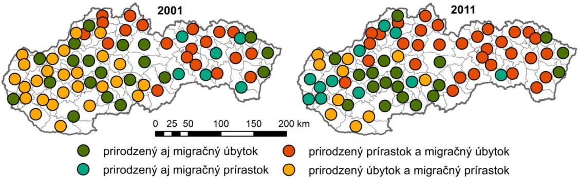
Migration and natural reproduction of population
Which population phenomenon directly affects changes in the number or spatial distribution of the population?
  migration
  natural reproduction (natural increase)
At which spatial level can migration and
natural reproduction influence the development
of the total population size?
  Local?
  Regional?
  National?
  Continental?
  Planetary?
Relationship between migration and natural population change in the districts of Slovakia
in 2001 and 2011; Source: Michal Gazda & Ladislav Novotný (2014)

Slide 6
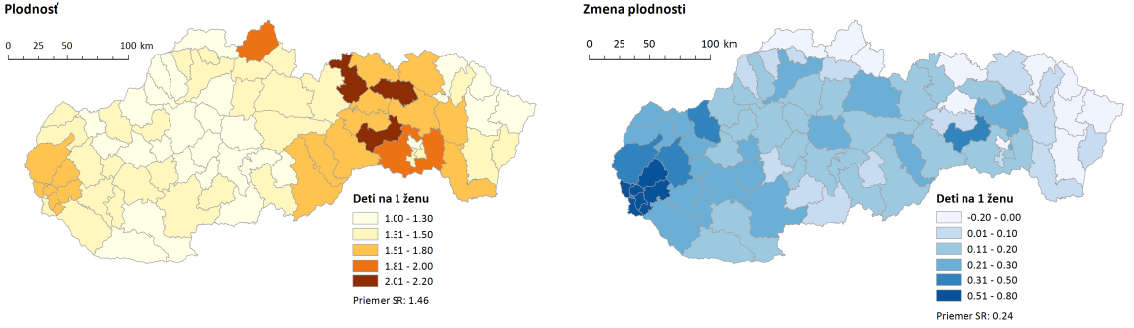
Migration and natural reproduction of population
Which population phenomenon directly affects changes in the number or spatial distribution of the population?
  migration
  natural reproduction (natural increase)
At which spatial level can migration and
natural reproduction influence the development
of the total population size?
  Local?
  Regional?
  National?
  Continental?
  Planetary?
Fertility rate
Change in fertility rate
Children per woman
Children per woman
average of Slovakia: 1.46
average of Slovakia: 0.24
Total fertility rate in 2014-2018 and changes in fertility between 2000-2004 and 2014-2018 in the districts of Slovakia
Source: Branislav Šprocha, Boris Vaňo, Branislav Bleha (2019): Regions and Districts of Slovakia from a Demographic Perspective.

Slide 7
Migration and natural reproduction of population
Which population phenomenon directly affects changes in the number or spatial distribution of the population?
  migration
  natural reproduction (natural increase)
At which spatial level can migration and
natural reproduction influence the development
of the total population size?
  Local?
  Regional?
  National?
  Continental?
  Planetary?
Relationship between migration and natural population change in the districts of Slovakia
in 2001 and 2011; Source: Michal Gazda & Ladislav Novotný (2014)

Slide 8
Migration and natural reproduction → spatial redistribution of populaton
What has a greater impact on the development of the population size of Slovakia?
What has a greater impact on the development of the population size of the Košice FUR?
What has a greater impact on the development of the population size of the city of Košice?
What has a greater impact on the development of the population size of the Košice-okolie district?

Slide 9
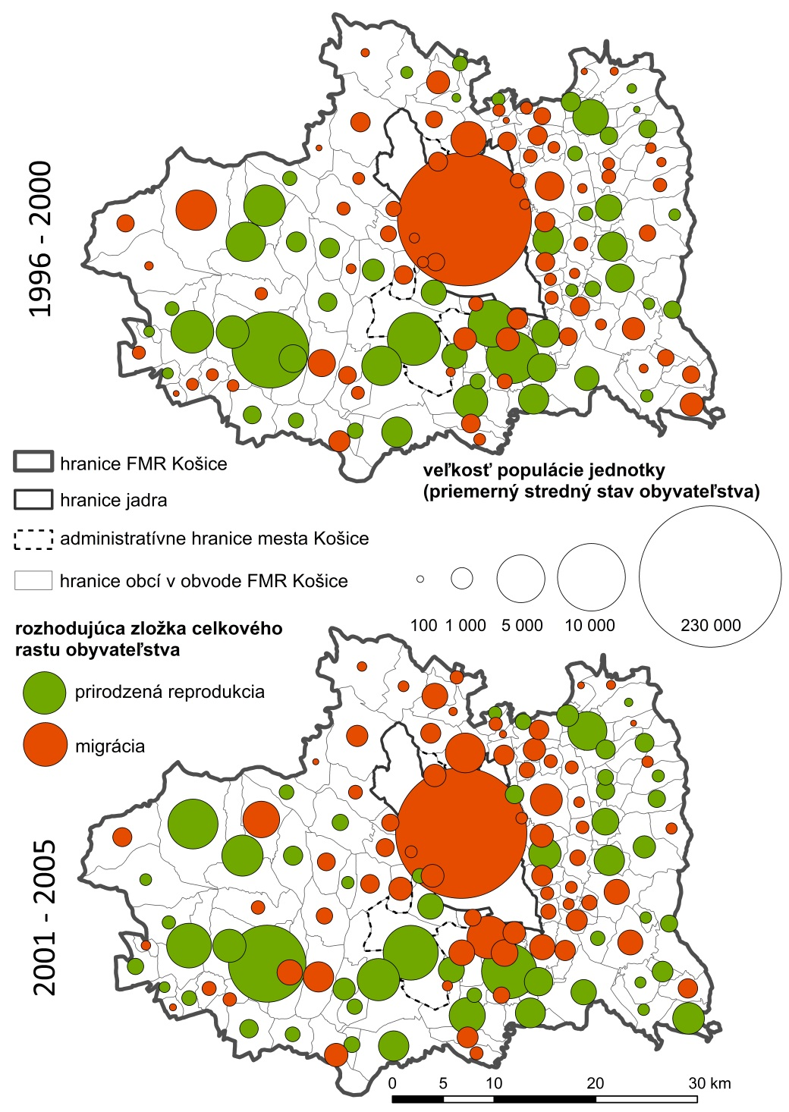
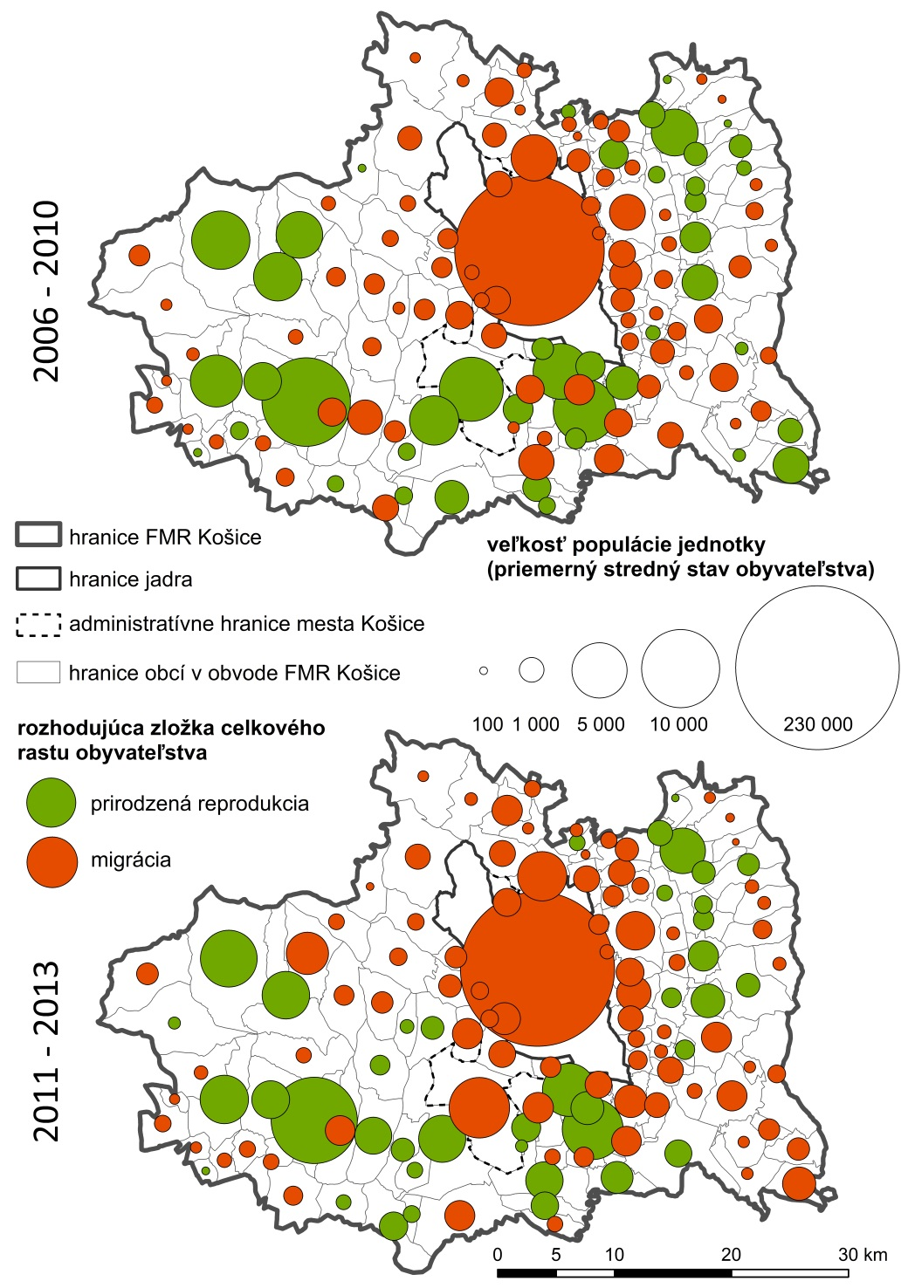
Spatial distribution of municipality types in the Košice FUR according to the determining component of total population growth;
Source: Novotný (2014)
determining component of total population growth
determining component of total population growth
natural reproduction
natural reproduction
migration
migration

Slide 10
Migration and natural reproduction → spatial redistribution of populaton
What has a greater impact on the development of the population size of Slovakia?
What has a greater impact on the development of the population size of the Košice FUR?
What has a greater impact on the development of the population size of the city of Košice?
What has a greater impact on the development of the population size of the Košice-okolie district?

Slide 11
Thanks a lot for attention!

