Slide 1
Migration and Human Capital

Slide 2
Migration
What is migration?
B
A

Slide 3
Migration
What is migration?
B
A
IOM (2019): The movement of persons away from their place of usual residence, either across an international border or within a state
IOM (2022): Movement of individuals or groups of people in geographic and social space associated with a temporary or permanent change of place of residence
Jurčová (2005): Movement across the boundaries of an administrative unit that results in a change of a person’s permanent residence
Jurčová (2005): Changes in the population resulting from spatial movement during which a change of a resident’s permanent (usual) place of residence occurs

Slide 4
Migration
What is migration?
B
a spatial (or social) phenomenon
a specific individual action
A
IOM (2019): The movement of persons away from their place of usual residence, either across an international border or within a state
IOM (2022): Movement of individuals or groups of people in geographic and social space associated with a temporary or permanent change of place of residence
Jurčová (2005): Movement across the boundaries of an administrative unit that results in a change of a person’s permanent residence
Jurčová (2005): Changes in the population resulting from spatial movement during which a change of a resident’s permanent (usual) place of residence occurs

Slide 5
Migration (and mobility)
spatial or social phenomenon?
B
A
Spatial unit
Social layer

Slide 6
Social migration (or rather mobility)
More frequently social mobility
Related with social stratification of population
the structuring of society into social layers
Movement of individuals, or in an intergenerational sense also families, between social strata
Individual or intergenerational social mobility
Slovakia ranks among the EU countries with the lowest levels of social mobility (Sopóci et al. 2021)
which makes migration even more important for the spatial redistribution of human capital
B
A

Slide 7
Migration (in geographic space)
What are the key characteristics of migration?
B
A

Slide 8
Migration (in geographic space)
What are the key characteristics of migration?
B
Selectivity
A
Type of crossed territorial unit
Motivation
Distance (O-D)
Duration (regularity)
Formality (registration)
Legality

Slide 9
Migration by type of crossed territorial (administrative/statistical/regional) unit
International vs. Internal
In the EU, international migration is differentiated into migration within the EU and migration from third countries
Internal migration occurs within individual countries
Interregional vs. intraregional
- regions:
Intermunicipal vs. intramunicipal

Slide 10
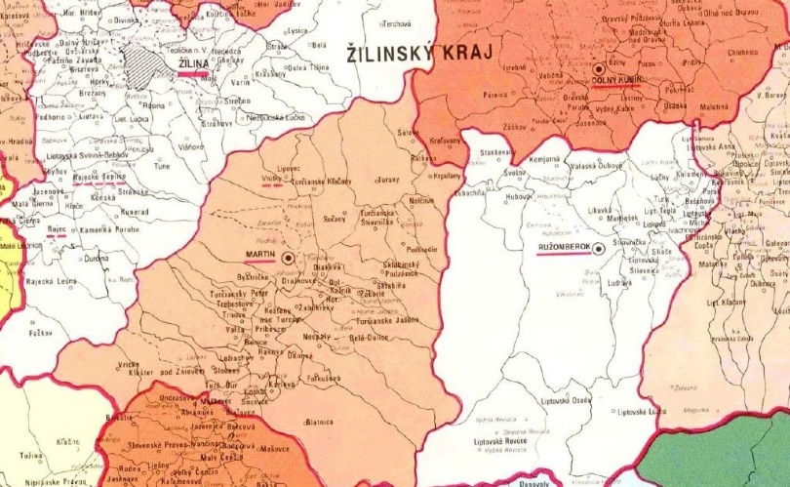
Migration by type of crossed territorial (administrative/statistical/regional) unit
International vs. Internal
In the EU, international migration is differentiated into migration within the EU and migration from third countries
Internal migration occurs within individual countries
Interregional vs. intraregional
- regions: districts, counties, nodal regions, functional urban regions,...
Intermunicipal vs. Intramunicipal
every international and interregional migration is, logically, also inter-municipal
the same is intraregional migration if occures between various municipalities
intra-municipal migraitons are not recorded in Slovakia
Bratislava and Košice are exemptions because migrations between neighbourhoods are recorded

Slide 11
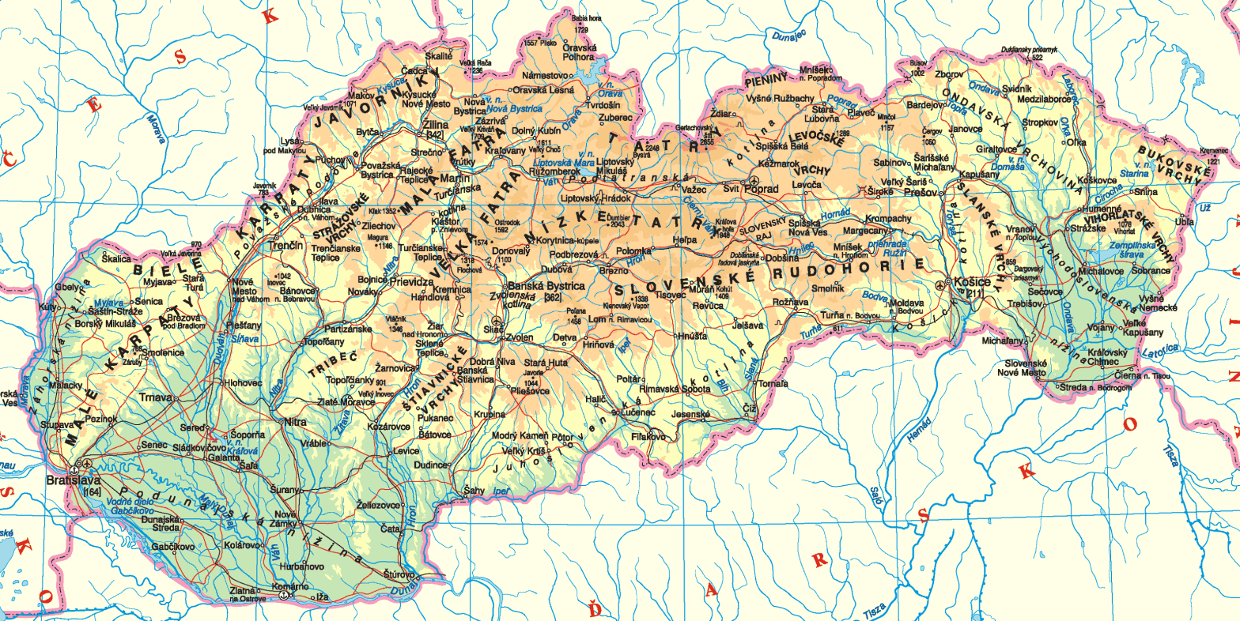
Migration by distance
spatial or temporal distance
short and long distance migrations
the boundary between them is not strictly defined
depends on the regional structure and is closely related to migration types by territorial unit crossed
is usually also differentiated according to the motive for migration

Slide 12
Migration by duration (regularity)
in the Slovak context, internal migration is perceived as de facto permanent act because it is defined by a change of permanent residence
in international migration, according to the UN definition, migration is considered a change of country of permanent or usual residence undertaken by a person for any reason, for a period of at least three months
in the terminology of the Slovak public administration, the term “migrant” is not used for such a person; instead, they are referred to as a “foreigner”, until they obtain a residence permit or permanent residence
based on this, migration is then distinguished as short-term (up to 1 year) and long-term (more than 1 year).
it is therefore possible to distinguish between one-time/permanent and regular/repeated migration
if temporary migration is recorded, upon returning to the country/area of origin it is referred to as re-migration
re-migration occures also in internal migration, which requires a change of permanent residence (most often from rural to urban areas and back, or vice versa), however, it is not directly recorded – thus it is barely observable

Slide 13
Migration by formality (registration)
registered (officially recorded)
formalised by a change of permanent residence, or by registering for temporary residence
possible recorded by census
international migration to Slovakia: by registering for permanent residence, obtaining a residence permit, etc.
emigration from Slovakia: by deregistering from permanent residence
mandatory by law but not enforceable
unrecorded
actual change of residence without official formalization
In Western countries, where migration records are not based on changes in permanent residence, it is reflected in statistics
often emigration from Slovakia
in research, it is necessary to rely on alternative data sources

Slide 14
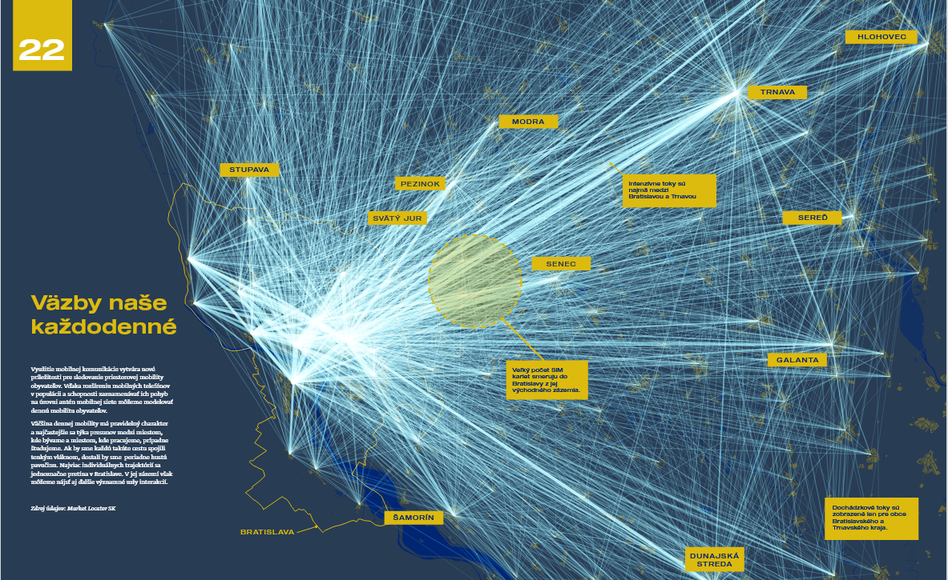
daily mobility according to data from mobile operators
Source: Šveda et al. 2021: Atlas SuburBAnizácie

Slide 15
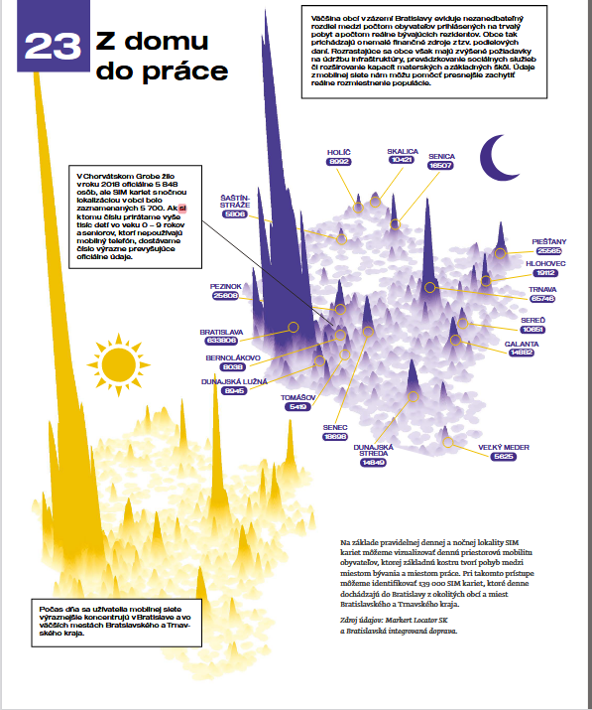
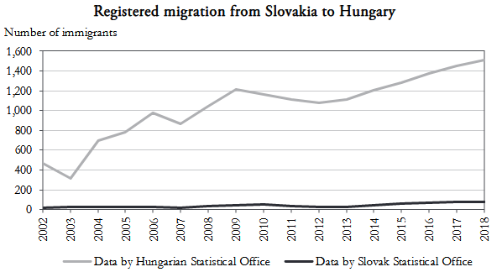
Migration by formality (registration)
possible sources of information on in
data from mobile operators
mainly used to identify commuting flows
useful compelmentary source of migration information
social insurance agency
tax authorities / financial administration
especially abroad
universities
foreign statistical offices
Pregi and Novotný (2022)
Source: Šveda et al. 2021: Atlas SuburBAnizácie

Slide 16
Migration by legality
in relation to internal migration in Slovakia, this distinction is not relevant, as Slovakia is a democratic country with freedom of movement
in relation to international migration:
legal migration – crossing a country’s border with valid travel documents (visas and permits, if required for migration to that country)
illegal migration – unauthorized crossing of a country’s border without valid travel documents, visas, or residence permits, or unauthorized stay in the country after the expiration of documents, visas, or residence permits

Slide 17
Migration by motivation
especially in relation to international migration:
forced migration – involuntary departure from the country of origin due to:
political and social problems
armed conflicts
natural disasters
severe existential and economic problems
other long-lasting crisis situations
voluntary migration – free movement of individuals or groups of people, most often for the purpose of:
employment
family reunification
education
change of social environment

Slide 18
Migration by motivation
internal migration in Slovakia is voluntary, two main groups of motives are distinguished:
following applies to most of internal migration in democratic countries
social-economic
for work or education
interregional, over longer distances
metropolization, counter-urbanization
social-environmental
for a better living environment, more accessible housing with larger living space, better access to services, etc.
intraregional, over shorter distances
urbanization, suburbanization, exurbanization

Slide 19
Selectivity of migration
the motivation (and thus the form, in terms of duration, formalization, etc.) is influenced by various characteristics of migrants, particularly:

Slide 20
Selectivity of migration
the motivation (and thus the form, in terms of duration, formalization, etc.) is influenced by various characteristics of migrants, particularly:
social status
education
age
nationality, ethnicity, religiosity...
spatial migration patterns differ across the various categories of migrants

Slide 21
Thanks a lot for attention!

