Slide 1
Migration and Human Capital

Slide 2
Spatial redistribution of population
Two substantially different spatial processes:
interregional migration
intraregional migration
  different motives
  different structure of migrants
  different consequences

Slide 3
Spatial redistribution of population
between regions
migration into a region from other regions
  migration gain of a region at the expense of others
  concentration
migration from a region to other regions
  migration loss of a region in favour of others
  deconcentration

Slide 4
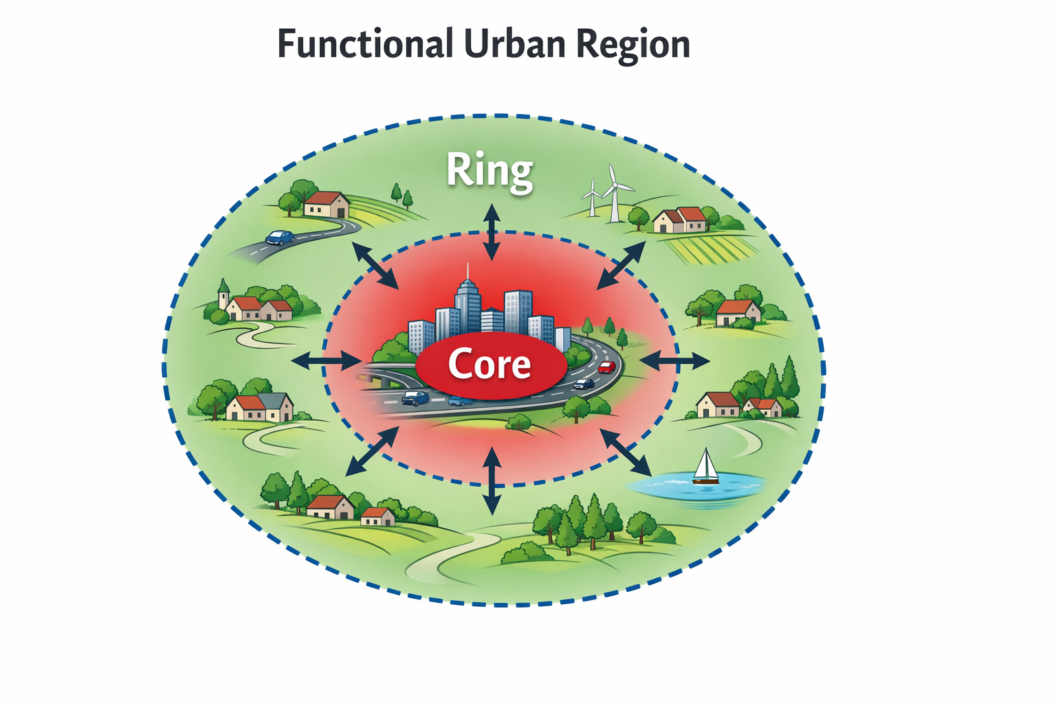
Spatial redistribution of population
within regions
migration from rural areas to cities
  in the past in developed countries
  currently in developing countries
  from the ring to the core of the region
  centripetal process – centralisation
migration from cities to rural areas
  currently in developed countries
  from the core to the ring of the region
  centrifugal process – decentralisation
Figure made by AI

Slide 5
Processes of spatial redistribution of population
interregional
  concentration
  deconcentration
intraregional
  centralisation
  decentralisation
although migration affects the entire territory of a region, urban change has historically been the key driver of migration and spatial population redistribution
regularities in migration‑driven spatial redistribution: urban development

Slide 6
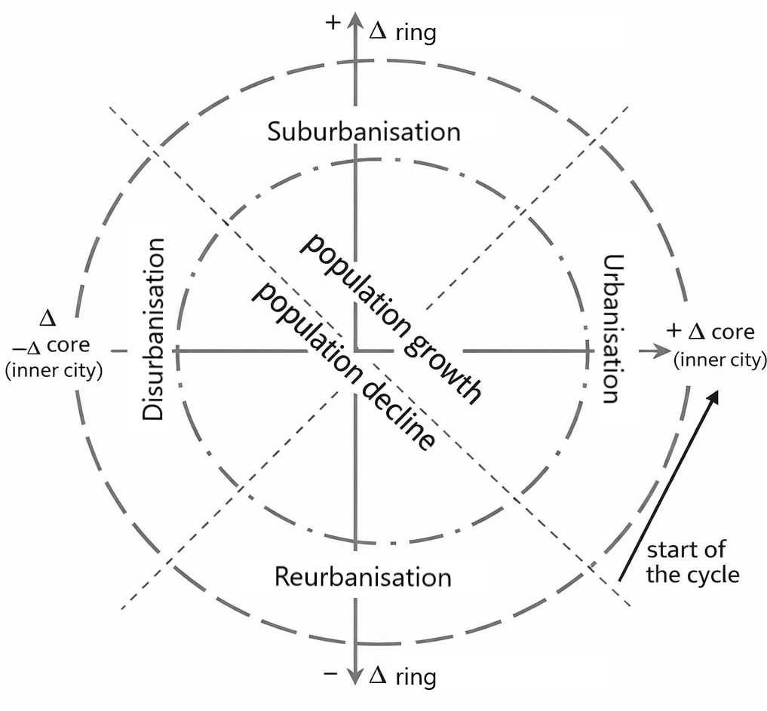
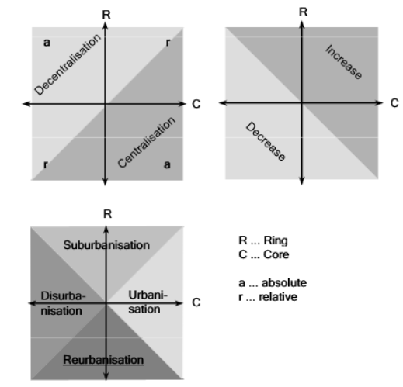
Models of urban development
Stages of urban development model
identifies stages based on the relationship between
the growth of the core and the ring
of a functional urban region
source

Slide 7
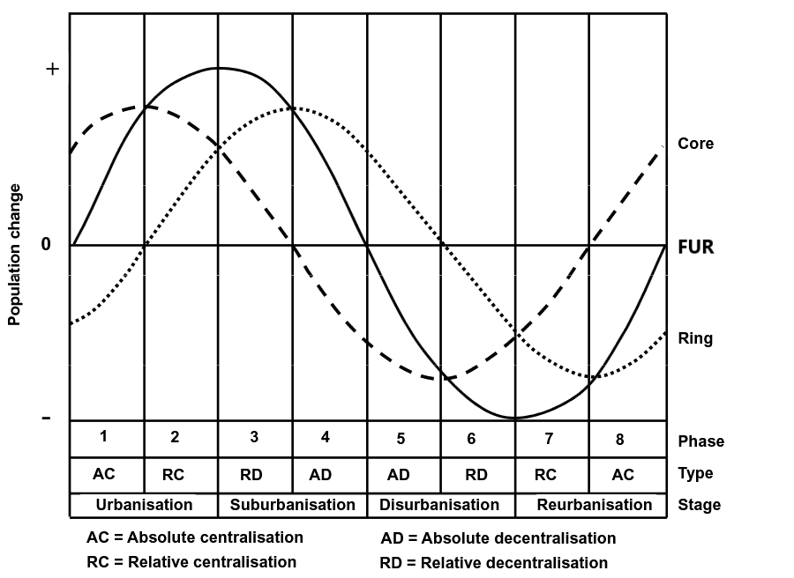
Models of urban development
Stages of urban development model
stages
  Urbanisation
  Suburbanisation
  Disurbanisation
  Reurbanisation

Slide 8
Models of urban development
Stages of urban development model
stages
  Urbanisation
  Suburbanisation
  Disurbanisation
  Reurbanisation
issues:
  is it better to use the net migration rate or absolute net migration?
  how can bias be avoided when core and ring have different population sizes?

Slide 9
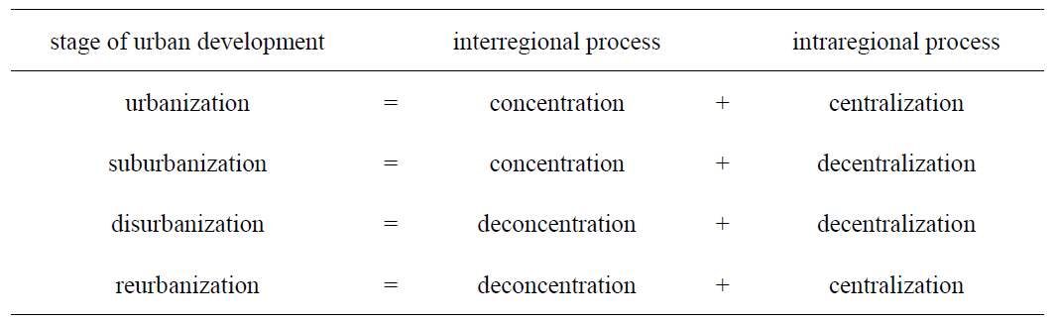
Models of urban development
Stages of urban development model
expression using the relationship between intraregional and interregional redistribution processes
issues:
  is it better to use the net migration rate or absolute net migration?
  how can bias be avoided when core and ring have different population sizes?

Slide 10
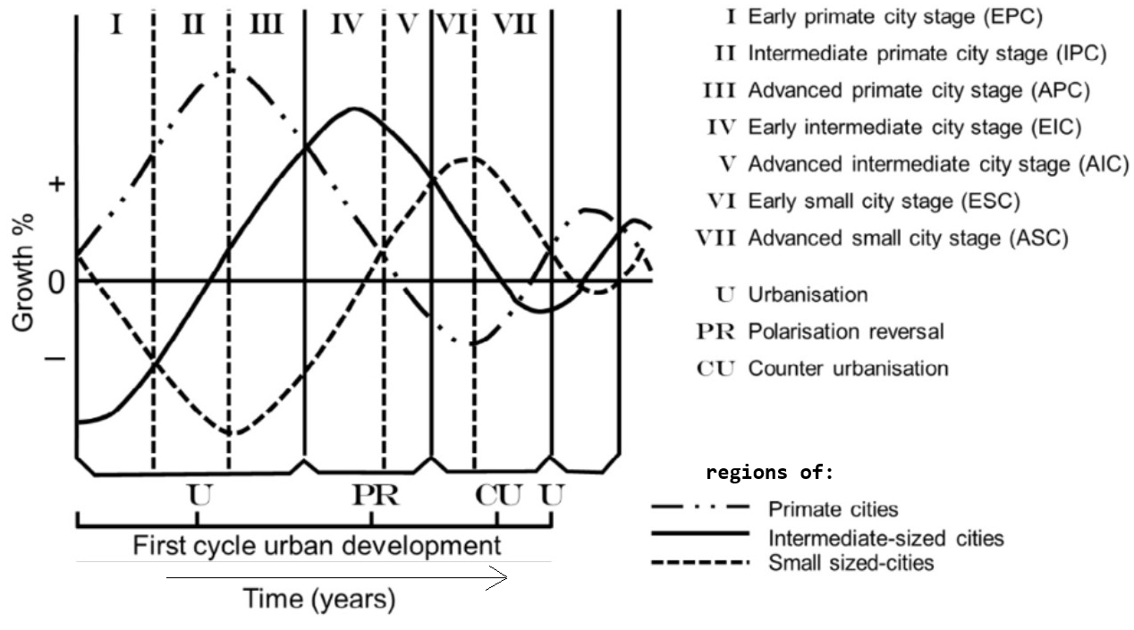
Models of urban development
Differential urbanisation model
Identifies phases of urban development
based on the growth relationship
of three categories of regions:
by size of the core
  population size
  position in the urban hierarchy
  economic size
  ...

Slide 11
Models of urban development
Differential urbanisation model
phases:
  urbanisation (metropolisation)
  polarisation reversal
  counterurbanisation

Slide 12
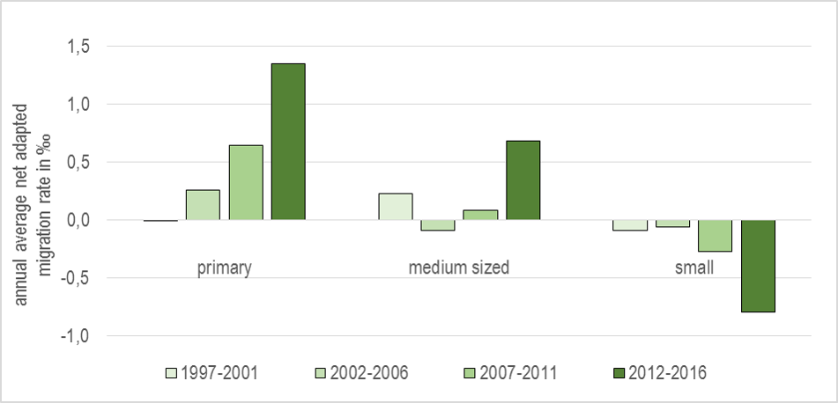
Models of urban development
Differential urbanisation model
phases:
  urbanisation (metropolisation)
  polarisation reversal
  counterurbanisation
Development of the intensity of urban processes in Eastern Slovakia

Slide 13
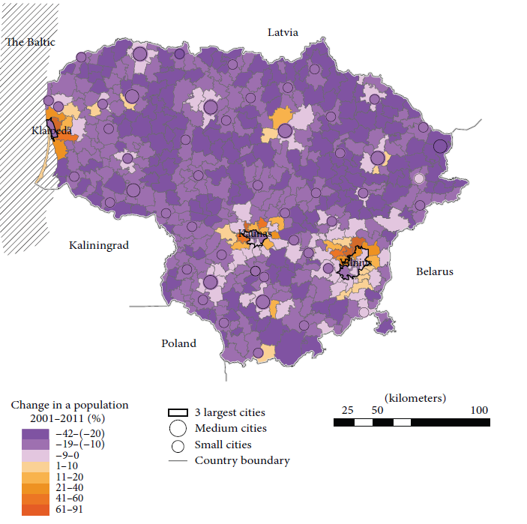
Example: Lithuania
What processes, phases and stages
of urban development can be identified
from the figure?
  Ubarevičiené, R., van Ham, M., Burneika, D. 2016.
  Shrinking Regions in a Shrinking Country:
  The Geography of Population Decline in Lithuania
  2001–2011

Slide 14
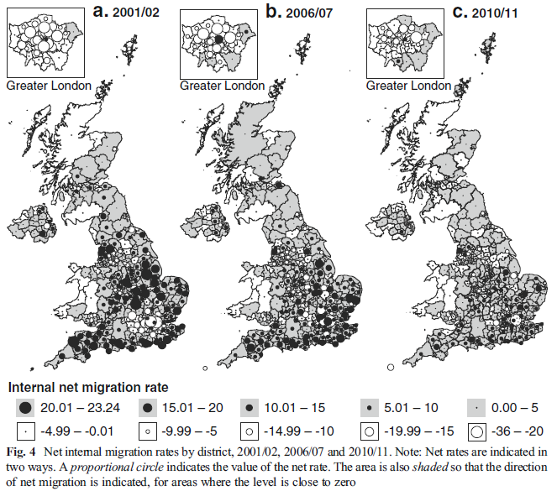
Example: United Kingdom
What processes, phases and stages
of urban development can be identified
from the figure?
  Lomax, N., Stillwell, J., Norman, P., Rees, P. 2014.
  Internal Migration in the United Kingdom...

Slide 15
Example: Slovakia and Hungary
What processes, phases and stages
of urban development can be identified
from the figure?
  Novotný & Pregi 2018. Visualization of migration using
  spatial interpolation method in Hungary and Slovakia.
  Regional Statistics, 8, 184-188

Slide 16
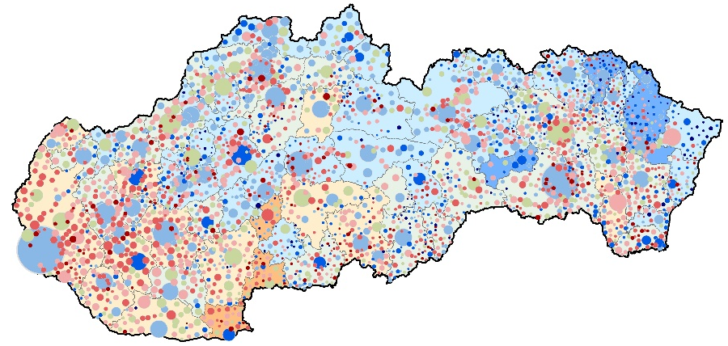
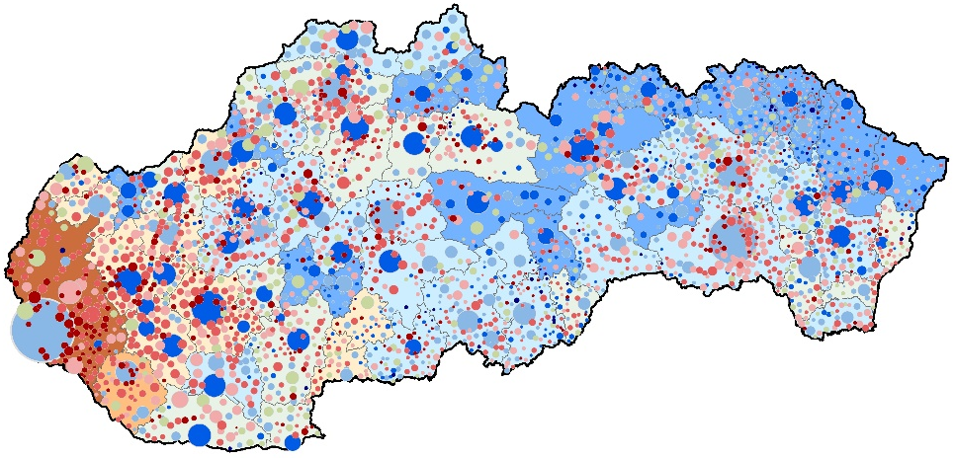
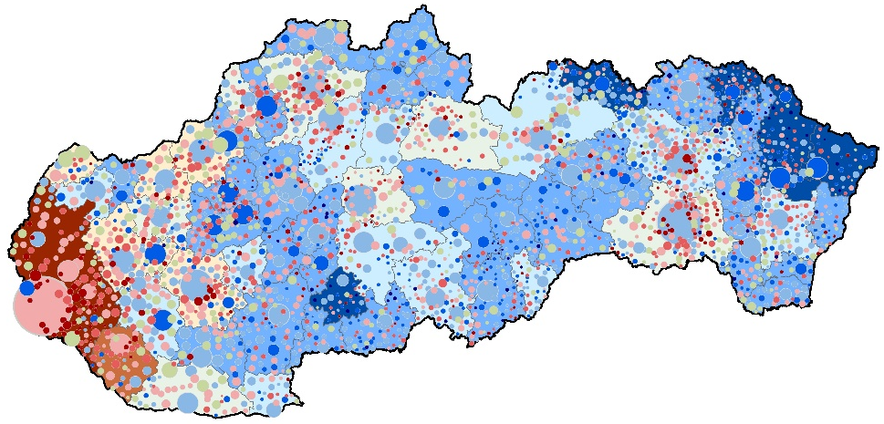
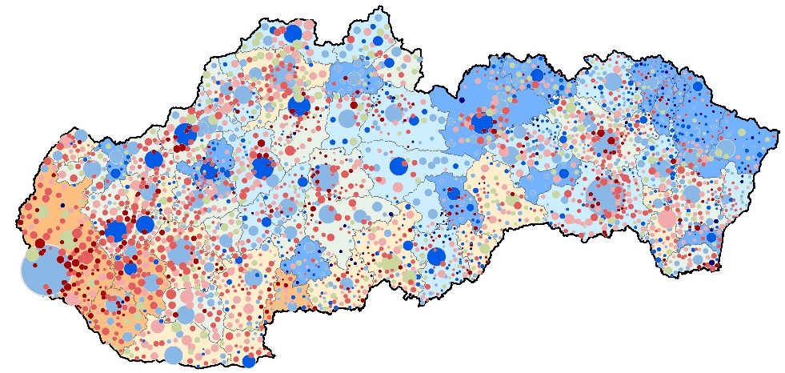
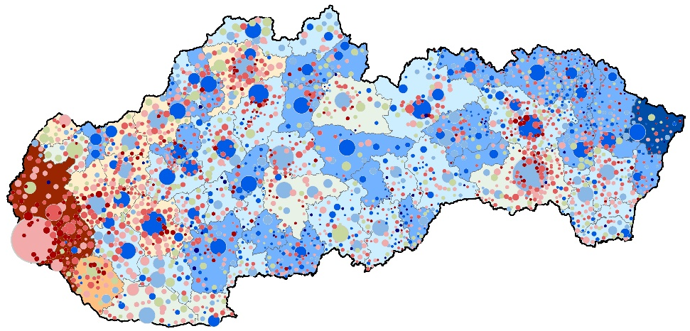
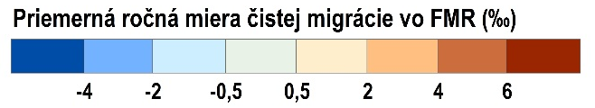


Regional and local dimension of urban development
1996-2000
2006-2010
2016-2018
2001-2005
2011-2015
gradual spatial polarization at both regional and local levels
  more pronounced growth only in the Bratislava
  and the Dunajská Streda FURs
  later growth of municipalities in the closest
  hinterland of larger cities
initial polarization followed by a later moderation across the size structure of municipalities
Annual average net migration rate in FURs in ‰
Annual average net migration rate in municipalities in ‰
Population size of municipalities
Regional system: FURs 01B (Bezák 2014)
Data source: SOSR – Anonymized data on individual
migrations 1996-2018

Slide 17
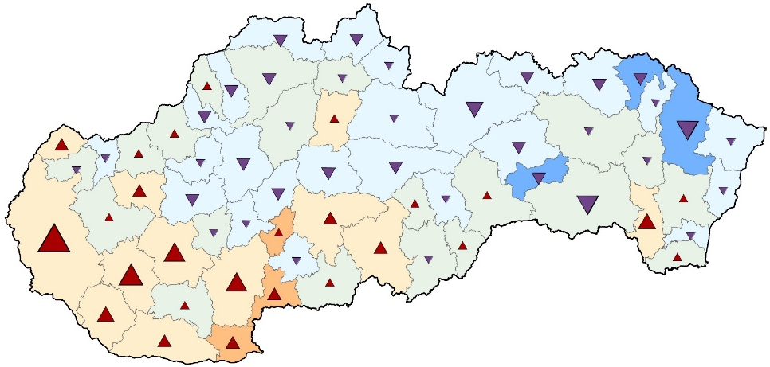
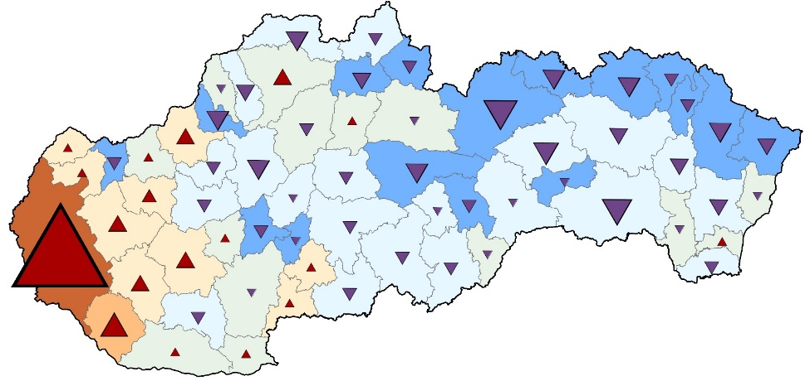
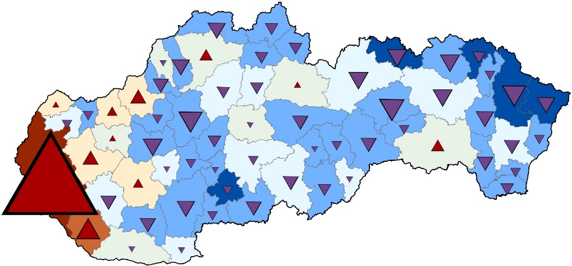
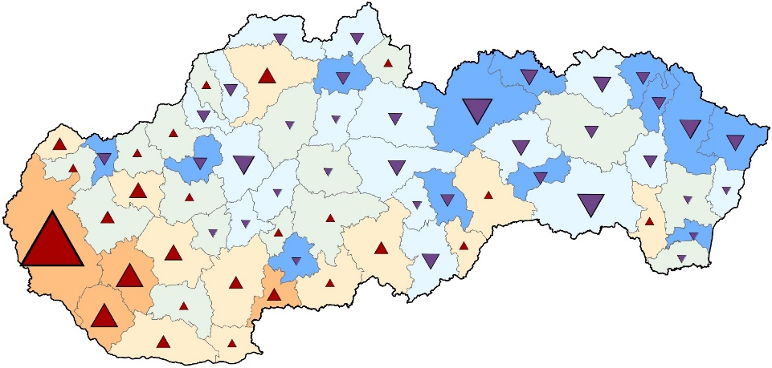
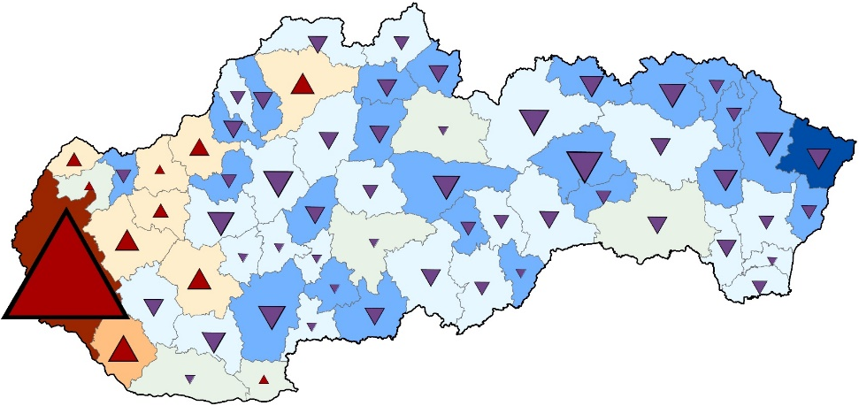
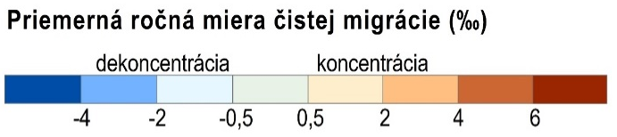
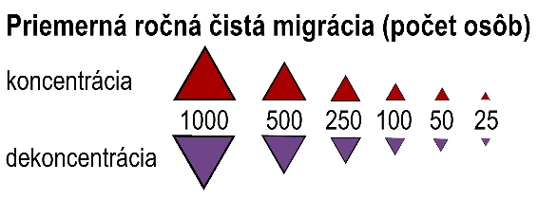
Urban development processes – concentration and deconcentration of population in regions of Slovakia
1996-2000
2006-2010
2016-2018
362
3138
6212
concentration: 26 FMR
deconcentration: 36 FMR
concentration: 18 FMR
deconcentration: 44 FMR
concentration: 11 FMR
deconcentration: 51 FMR
2001-2005
2011-2015
increasing polarisation
  system in the phase of metropolisation (urb.)
decreasing number of regions with concentration
  especially regions of medium-sized and small towns
  the specific position of the Bratislava FUR
  intensification of deconcentration in peripheral regions
  a positive turnaround in regions of larger towns/cities
1469
4745
concentration: 26 FMR
deconcentration: 36 FMR
concentration: 11 FMR
deconcentration: 51 FMR
Annual average net migration rate in ‰
Annual average net migration (in persons)
concentration
deconcentration
concentration
Regional system: FURs 01B (Bezák 2014)
Data source: SOSR – Anonymized data on individual
migrations 1996-2018
deconcentration

Slide 18
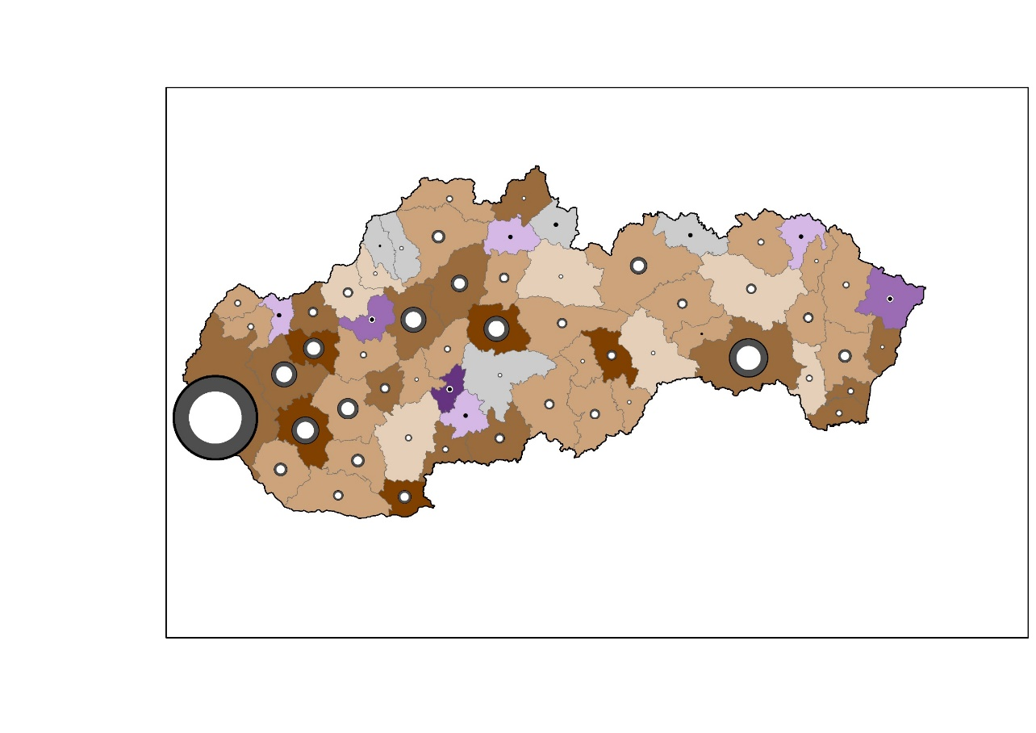
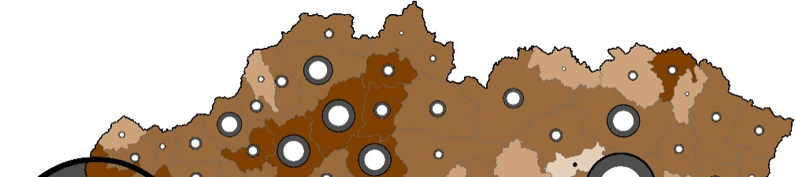
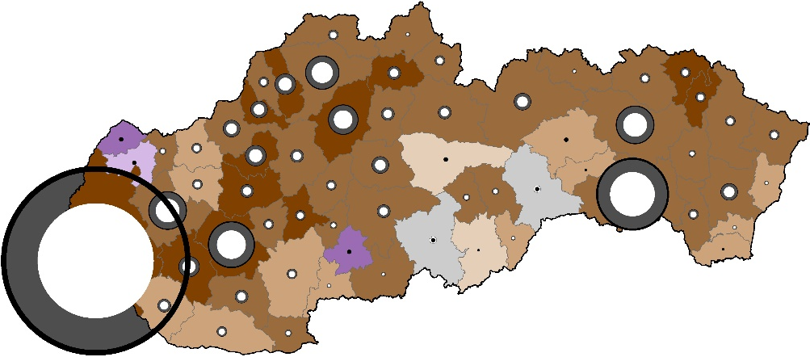
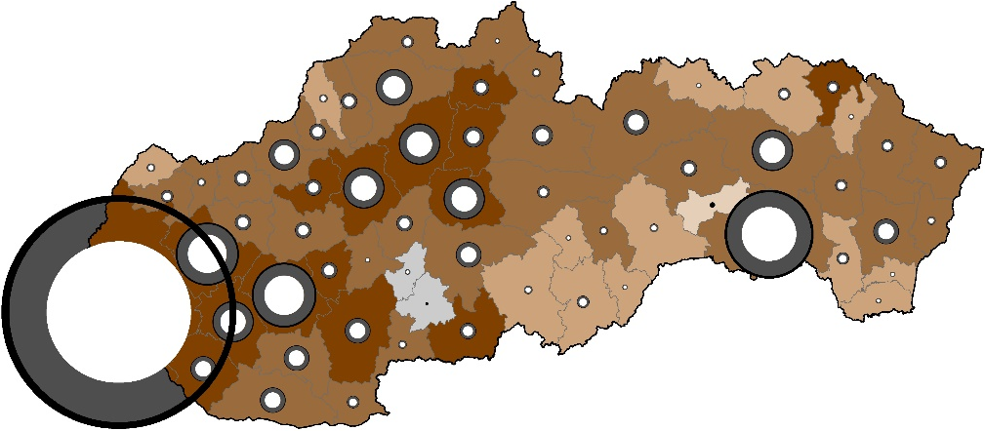
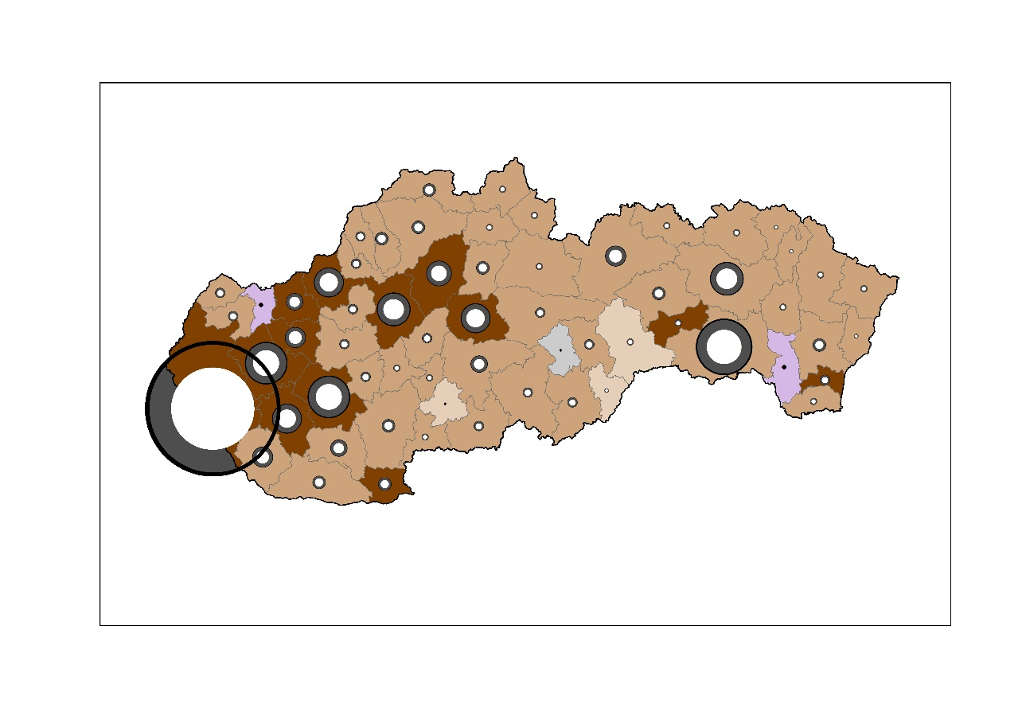
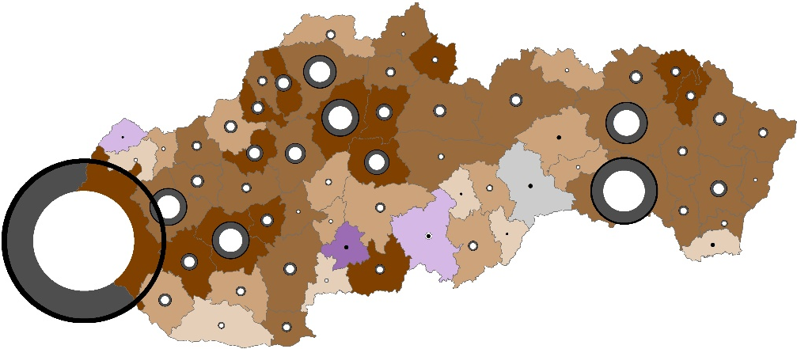
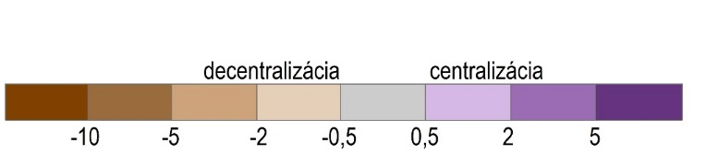

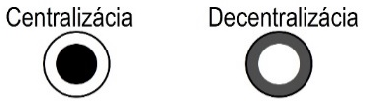
Urban development processes – centralization and decentralization of population in regions of Slovakia
1996-2000
2006-2010
2016-2018
2006-2010
-4480
-4388
-1713
-1935
centralisation: 10 FMR
decentralisation: 52 FMR
centralisation: 2 FMR
decentralisation: 60 FMR
centralisation: 8 FMR
decentralisation: 54 FMR
2001-2005
dominant decentralization
  increasing intensity
  peak during the crisis around 2008
  afterwards stagnation or reversal
increase in number of regions
with centralization
  including regions of medium‑sized cities
  exception: FMR Košice, Prešov
2001-2005
2011-2015
-3160
-3933
centralisation: 3 FMR
decentralisation: 59 FMR
centralisation: 8 FMR
decentralisation: 54 FMR
Difference between net migration rate in core and ring (‰-points)
Rozdiel medzi hodnotou čistej migrácie v jadre a obvode (počet osôb)
Difference between net migration in core and ring (in persons)
centralisation
decentralisation
2000
1500
1000
500
100
centralizácia decentralizácia
centralisation
decentralisation
Regional system: FURs 01B (Bezák 2014)
Data source: SOSR – Anonymized data on individual
migrations 1996-2018

Slide 19
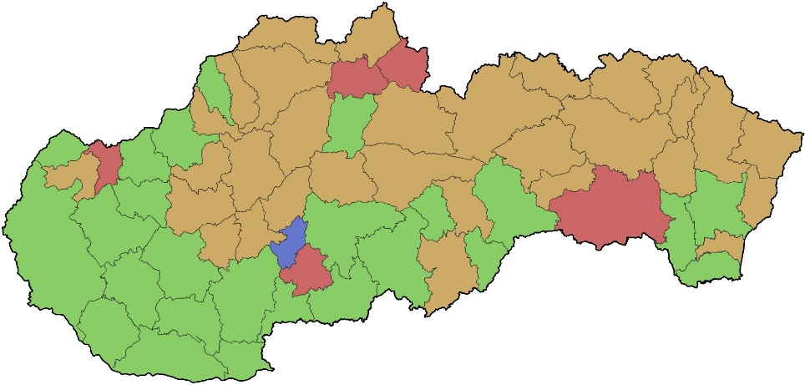
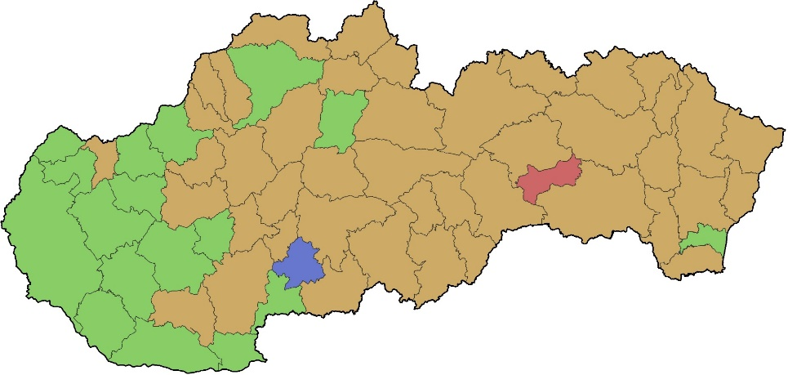
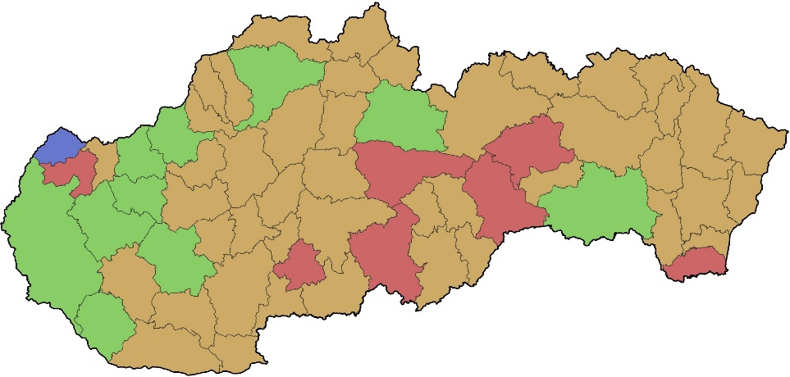
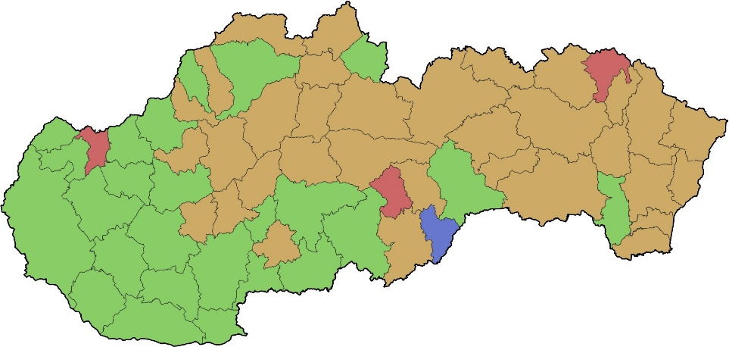
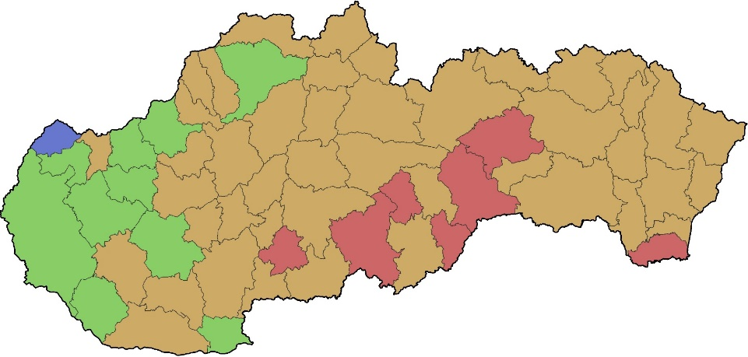
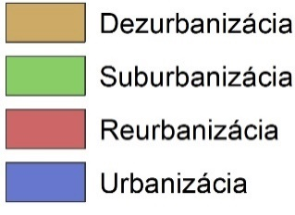


Stages of urban development
1996-2000
2006-2010
2016-2018
5
17
7
10
25
43
31
44
2001-2005
2011-2015
dominance of the disurbanisation stage
  an increasing number of regions in this stage
  a decline in the number of regions in the suburbanisation stage
    currently limited to regions of the largest cities and their adjacent areas
  reurbanisation also occurring in regions of medium-sized towns
Košice FUR
  transition through three stages in the reverse order
7
10
25
33
44
Urbanisation
Suburbanisation
Order of stages as proposed by Klaasen and Scimemi (1981):
urbanisation → suburbanisation → disurbanisation → reurbanisation
Regional system: FURs 01B (Bezák 2014)
Data source: SOSR – Anonymized data on individual
migrations 1996-2018
Disurbanisation
Reurbanisation

Slide 20
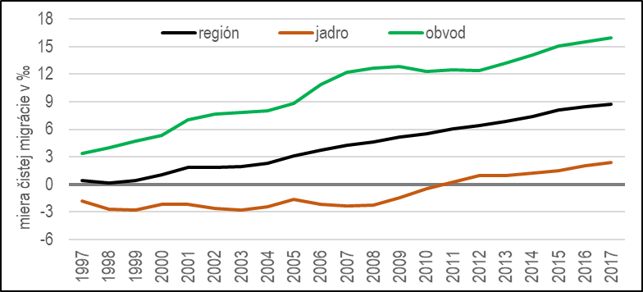
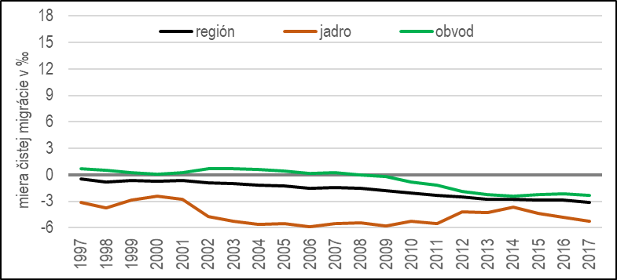
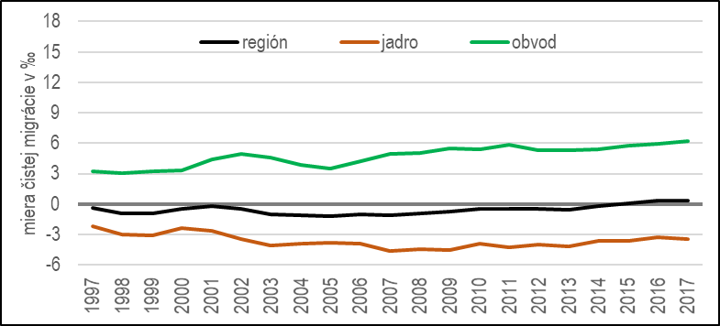
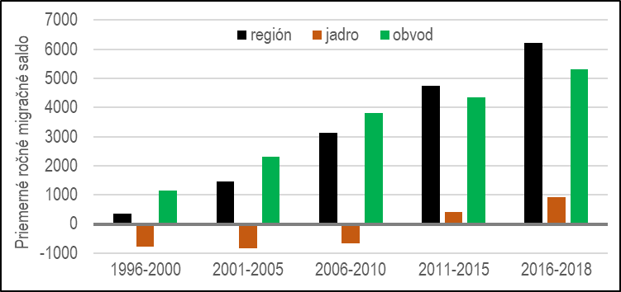
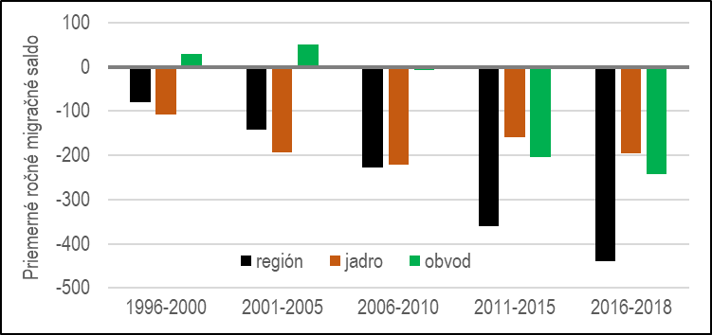
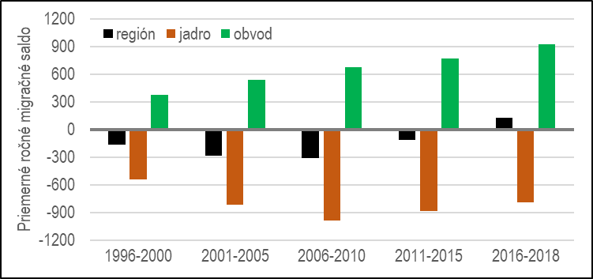
Intraregional urban development in selected regions
Bratislava FUR
Spišská Nová Ves FUR
Košice FUR
region
core
ring
region
core
ring
region
core
ring
net migration rate in ‰
net migration rate in ‰
net migration rate in ‰
region
core
ring
region
core
ring
annual average migration balance
annual average migration balance
annual average migration balance
region
core
ring
1996-2018: core: −6 750 core: −3 983 core: −18 503
migration balance ring: 73 955 ring: −1 375 ring: 14 534
region: 67 205 region: −5 358 region: −3 969

Slide 21
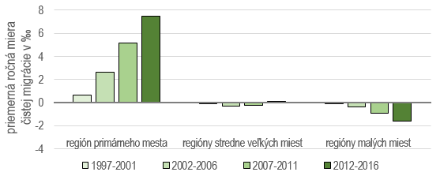
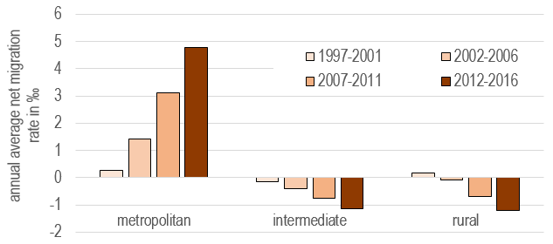
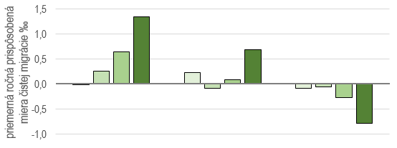
Urban development in regional systems
Gradual transition to a clear phase of metropolisation
in the whole regional system of Slovakia
and also in the East Slovak subsystem
Regional system of Slovakia
annual average
net migration rate in ‰
Primate city region Medium-sized city regions Small towns regions
Regional system of East Slovakia
annual average
net migration rate in ‰
Development of regional systems and subsystems by the population size of towns
Novotný, Pregi, Kmec (2018): Regionálny subsystém východného Slovenska v modeli diferenciálnej urbanizácie. In Kulla, Novotný eds. Zborník abstraktov z 8. Medzinárodného geografického kolokvia v Danišovciach. Košice (UPJŠ)
Development of regional systems based on their „rurality“
Novotný (2019): Impact of Migration on Rural Region in Post-Socialist Slovakia. In. Bański. J. ed. Three Decades of Transformation in the East-Central European countryside. Cham (Springer), 165-189.

Slide 22
Thanks a lot for attention!

